Slide 1
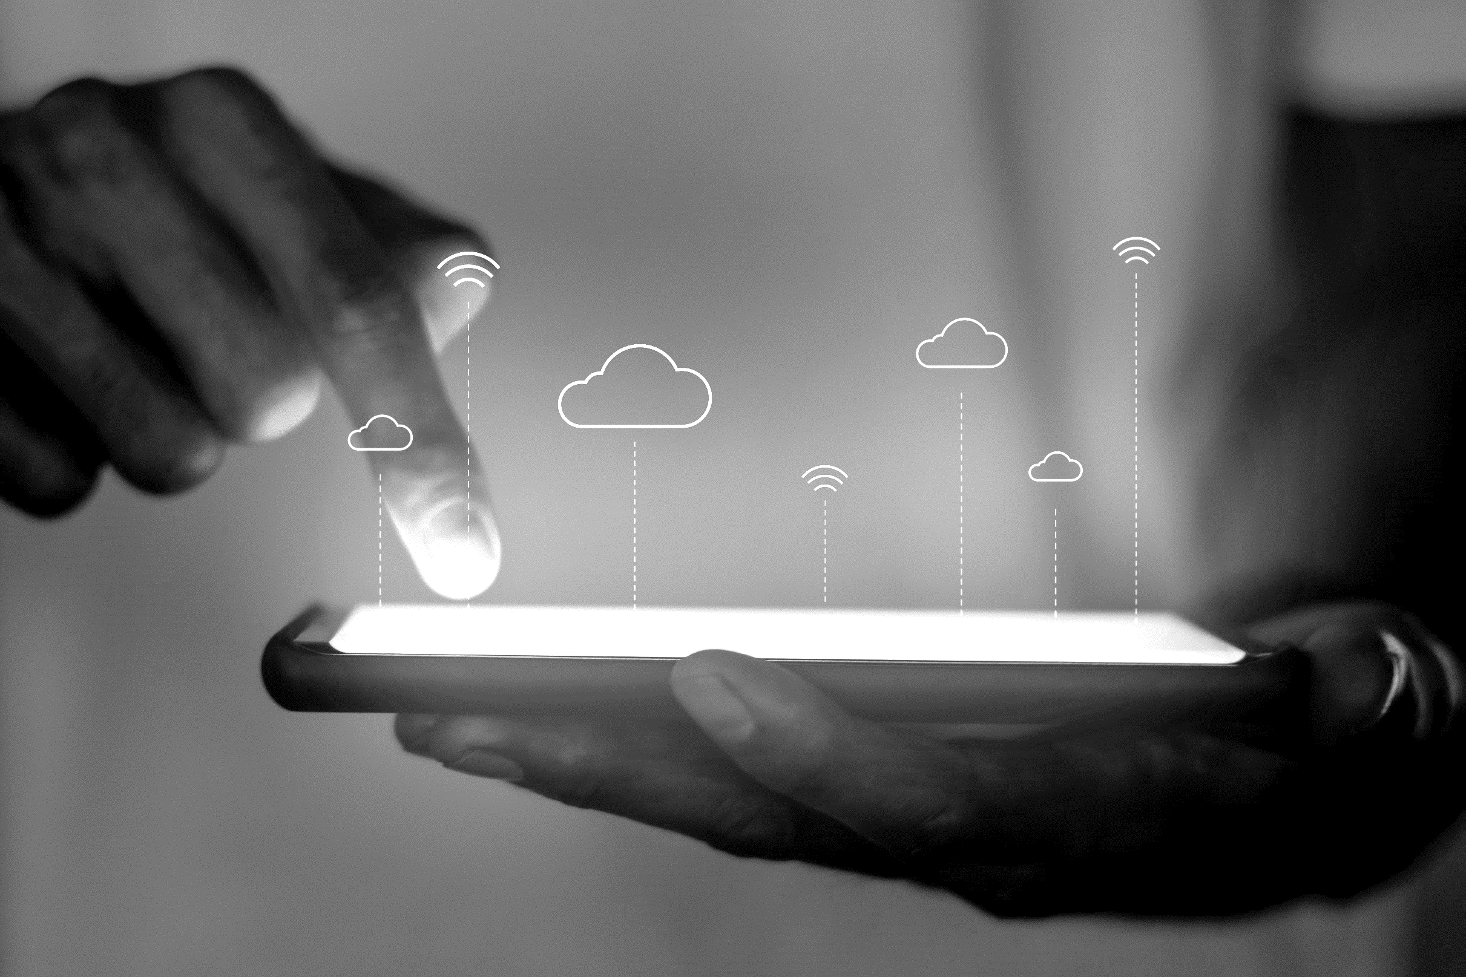

سال
المجرب
REVIEWS PLATFORM

Slide 2

PROBLEM
A pitch deck or a startup pitch deck is the most effective way to communicate your agenda, financial plans, and other improvement schemes before your audience. For investors, it gives them the motive to spend on your business idea.
Consumers feedback is being
Neglected and wasted for most of the times.
Bad quality of the offering is common between the Algerian consumers.

Slide 3

WHY
NOW?
Evolution of your product Category
Thus, we have designed this PPT template using high-quality graphics that unicorn startups can use to present their idea before venture capitalists or private investors.
Thus, we have designed this PPT template using high-quality.
33.1 %
Consumers feedback is being
Neglected and wasted for most of the times.

Slide 4


SOLUTION
Thus, we have designed this PPT template using high-quality graphics that unicorn startups can use to present their idea before venture capitalists or private investors.
Use Case 1
Thus, we have designed this PPT template using .
Value Proposition
Consumers feedback is being
Neglected and wasted for most of the times.
Use Case 1
Thus, we have designed this PPT template using .

Slide 5
https://slidemodel.com/templates/sequoia-capital-powerpoint-pitch-deck/

